Slide 1

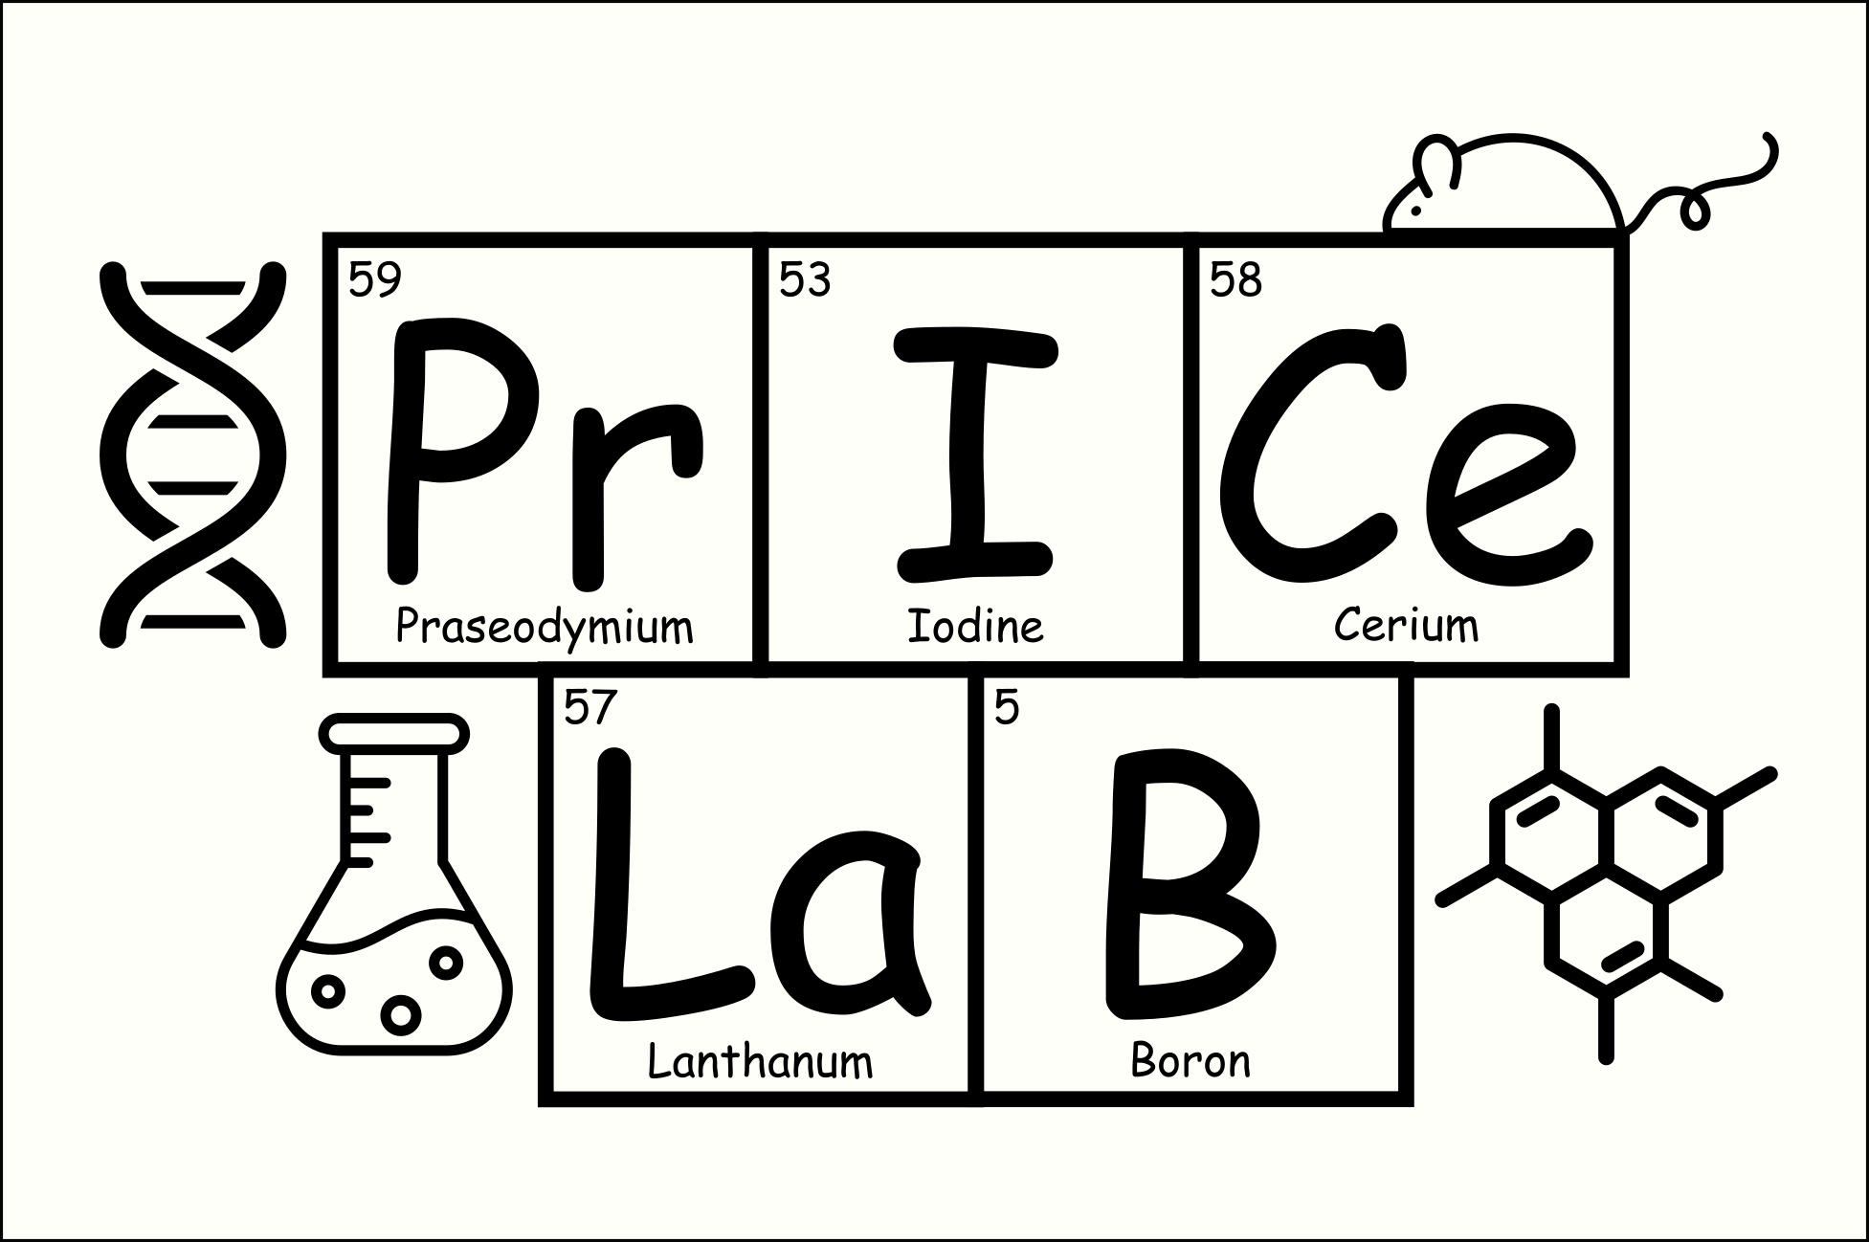
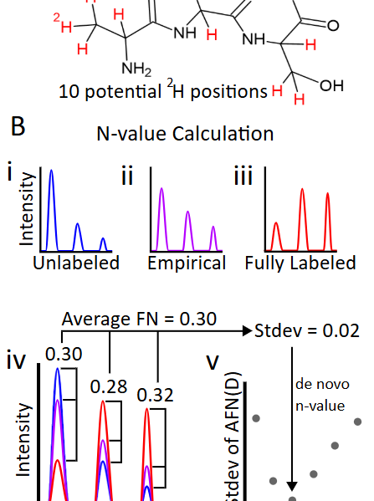

Assessment of Differences Between Literature and Empirical N-Values for Kinetic Proteomics
Benjamin Driggs, Coleman Nielsen, J.C. Price
Calorie restricted (CR), low protein (LP) diets increase longevity in mice, but why?
Four diet groups: LP CR, LP ad libitum (AL), HP CR, and HP AL
Using D2O as a metabolic label, we can measure the number of hydrogens in a molecule that can be replaced by deuterium (n-value).
Deconvolute peptide n-values to discover dietary-based changes in amino acid n-values.

